Slide 1
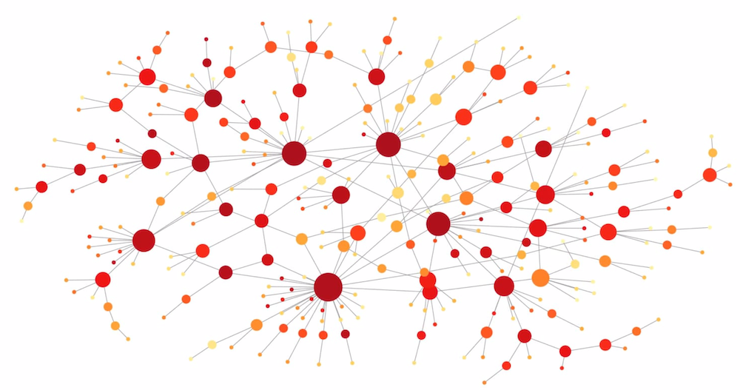
Temporal networks analysis: future directions

Slide 2
Link stream analysis
Edges
L =
0 0 … 1 0 0 0
How to aggregate? What are the relevant structures?
0 0 … 0 0 0 0
0 0 … 0 1 0 0
1 0 … 0 0 0 0
0 0 … 0 0 0 0
Time
0 0 … 1 0 0 0
0 0 … 0 0 0 1
0 0 … 1 1 0 0
0 1 … 0 0 0 0
0 0 … 0 0 0 1

Slide 3
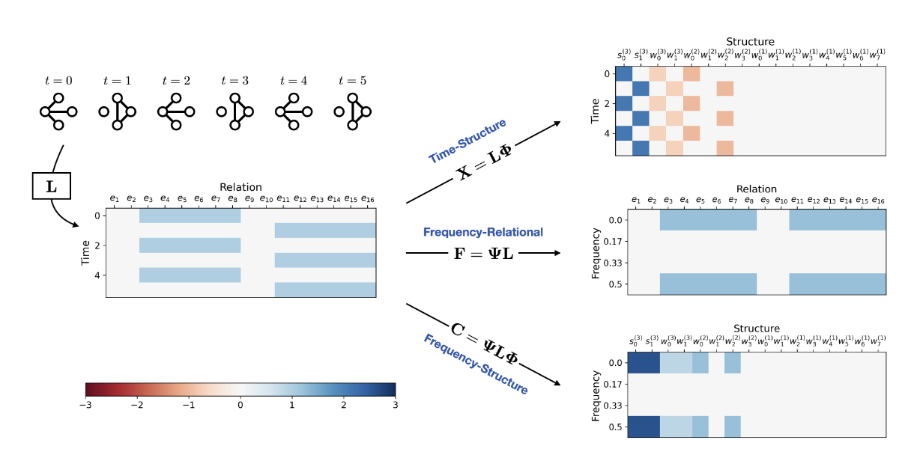
Link stream analysis
Edges
„Wavelet“ transform in „space“ to get relevant structures
Fourier transform in time to identify relevant timescales
L =
0 0 … 1 0 0 0
0 0 … 0 0 0 0
0 0 … 0 1 0 0
1 0 … 0 0 0 0
0 0 … 0 0 0 0
Time
0 0 … 1 0 0 0
0 0 … 0 0 0 1
0 0 … 1 1 0 0
0 1 … 0 0 0 0
0 0 … 0 0 0 1

Slide 4
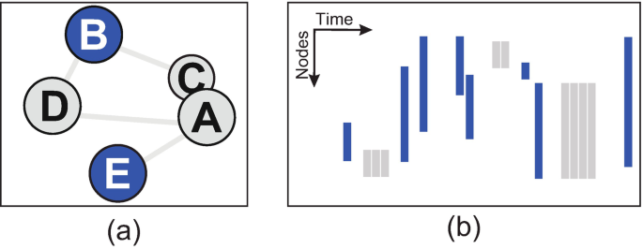
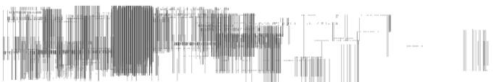
Visualization
Temporal layout:
Nodes
Time
People meeting in a museum dataset, Claudio Linhares et al. 2023

Slide 5
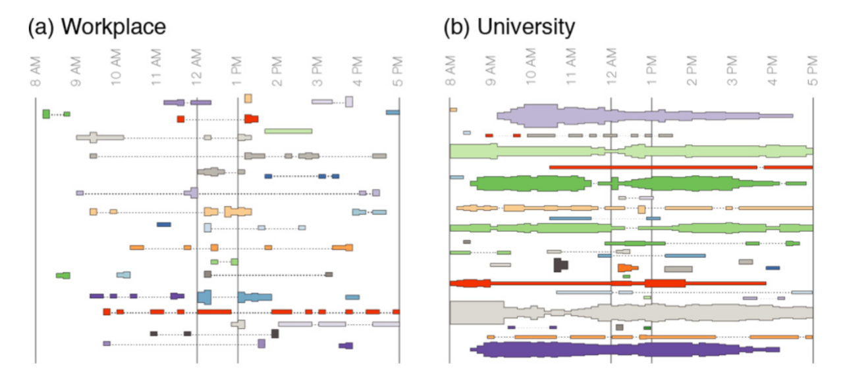
Visualization
Communities detection:
The coupling between time slices (or layers) captures intermitent communities as single entities. This coupling means that the graph becomes a 3D structure (not just a series of 2D slices) and this is what is used for community detection

Slide 6
Modelling
Activity-drive framework:
At each time step, each node form m connections with ist neighbors depending on its activity a, which defines a rate of activation (sort of poisson – like)
The m connections are made according to specific assumption, such as popularity, locality etc…
For however artificial this modeling strategy is, we can use it to analyse the nodes of a graph by fitting such a model to the data.

Slide 7
Modelling
Markov-chains:
Each possible edge is a state from the markov chain (I think? The paper is a poorly written…) and fitting is done via a bayesian approach.

Slide 8
Modelling
Random-walk / renewal process:
Model temporal graph either with n random walker evolving on a static structure and having a chance proportional to each static edge to jump (thus, an edge at time t is made)
Or
Model temporal graph by a renewal process on each of the possible edges, generating each edges as a function of time.
Allows to study diffusion among the network.

Slide 9
Time series analysis
Inter-event distribution
Burst size distribution
Autocorrelations
Memory coefficient
…
Bursty time series analysis for temporal networks, hang-hyun Jo & takayukia Hiraoka 2023

Slide 10
Graph embedding

